Slide 1
How Much Security is Enough?

Slide 2
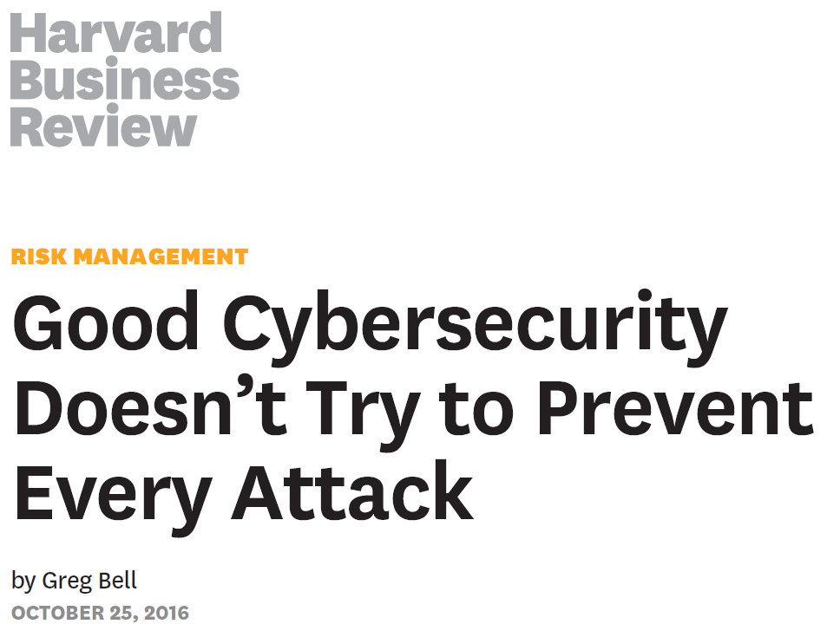

Slide 3


Slide 4
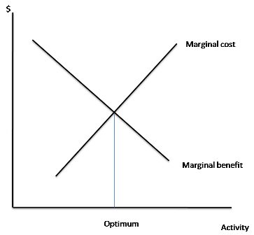

Slide 5
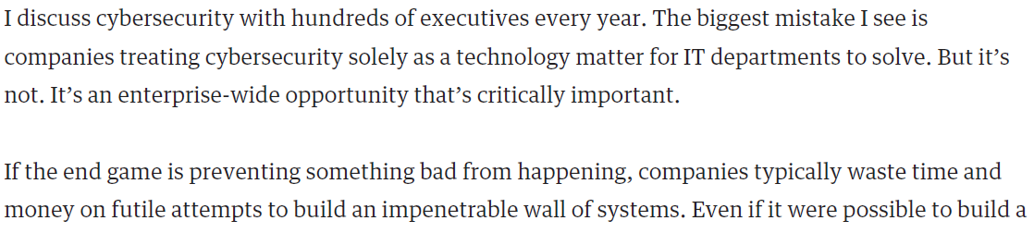
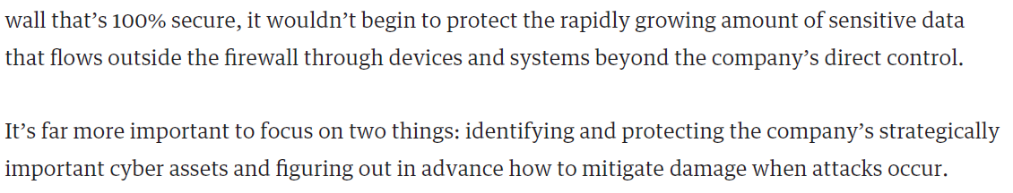

Slide 6
Two Goals of Cybersecurity
Prevention
Mitigation
There are others of course

Slide 7
Costs of Attacks - Mitigation
Cyber spending can decrease costs of incidents
  Incident response team
  Encryption
  Employee training
  Cyber-insurance

Slide 8
How Much?
How much should an organization spend on security?
  It depends!
Factors:
  Type of business
  Type of personal/sensitive data and IP
  Regulatory requirements
  Complexity of IT infrastructure
  Likelihood of being attacked
  Etc…

Slide 9

Texas A&M IP

Slide 10

Texas A&M IP

Slide 11
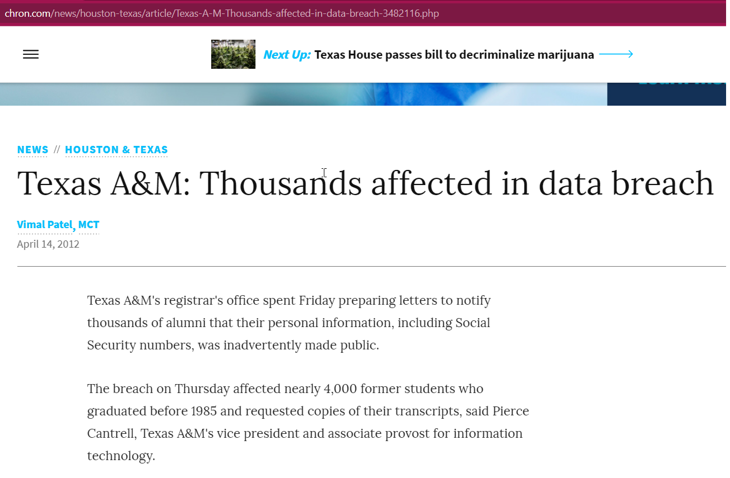

Slide 12
More Important Question
How should an organization go about determining how much to spend on security?
2019 CIO study – 15% of IT budget spent on security
  Small and large companies are similar
  Industries with highest percentage:
    Professional services
    Financial services
    High tech

Slide 13
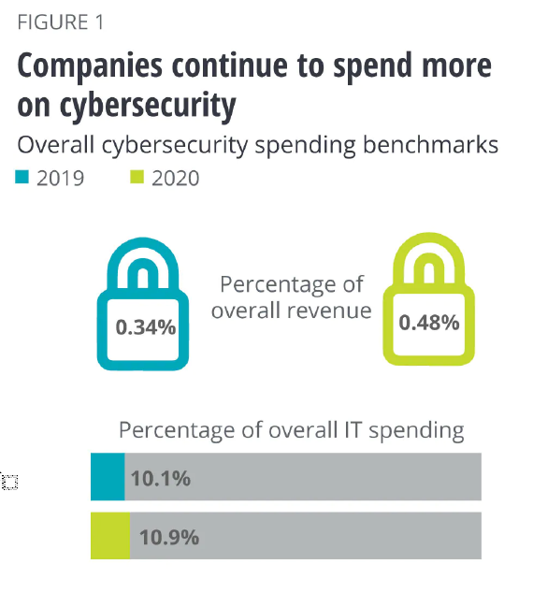

Slide 14
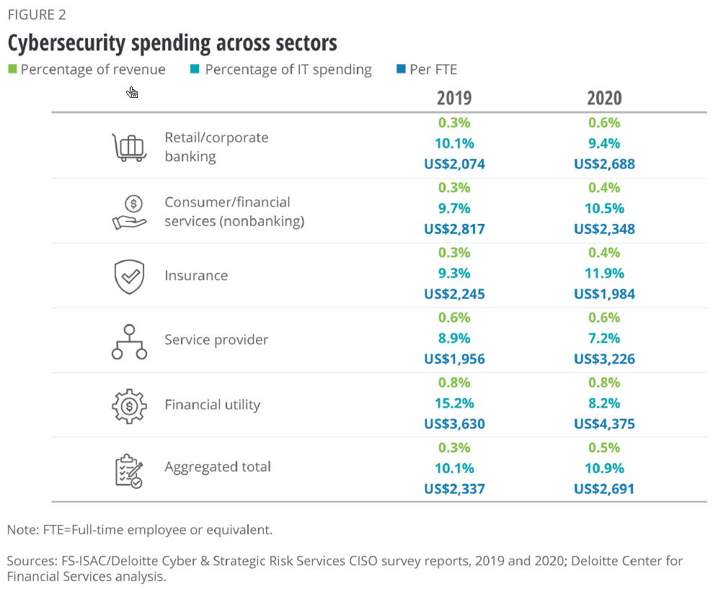

Slide 15
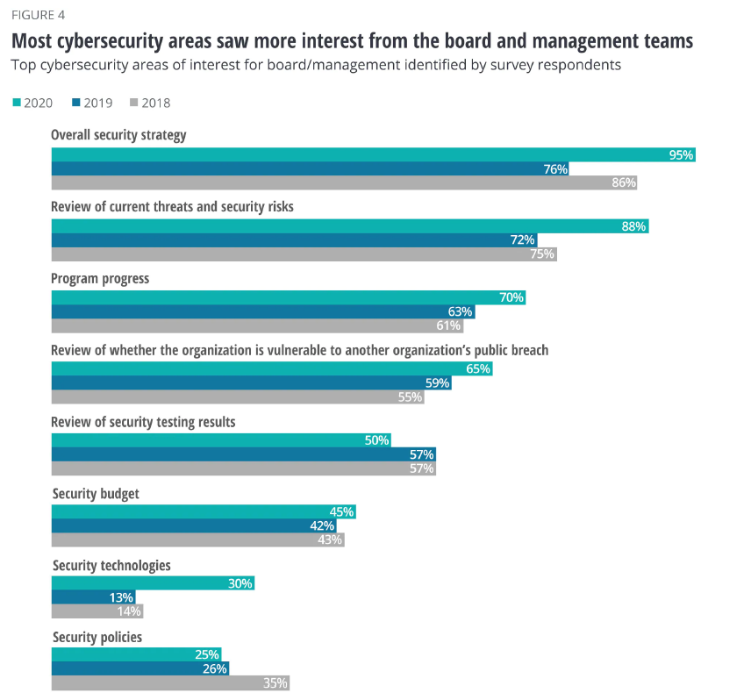

Slide 16
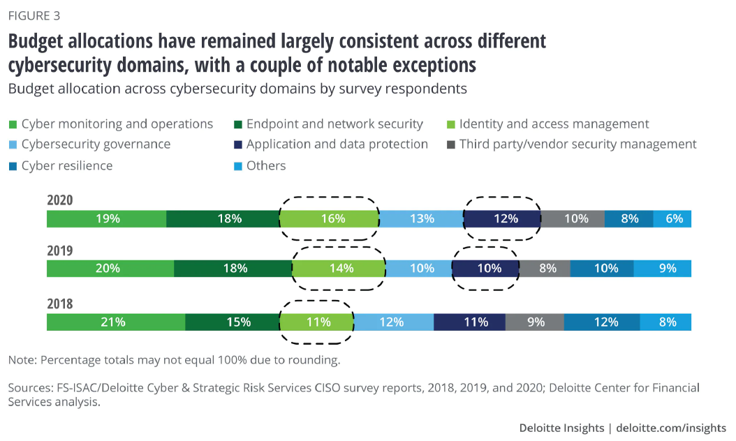

Slide 17
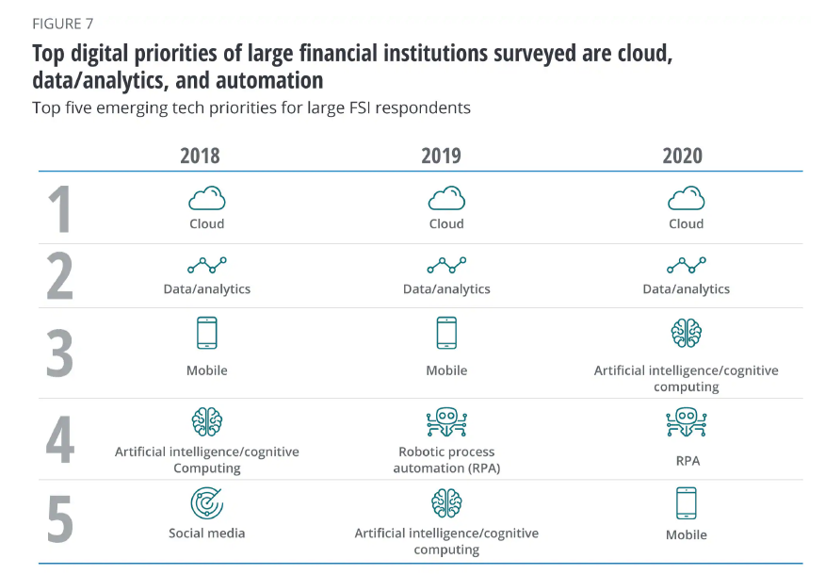

Slide 18
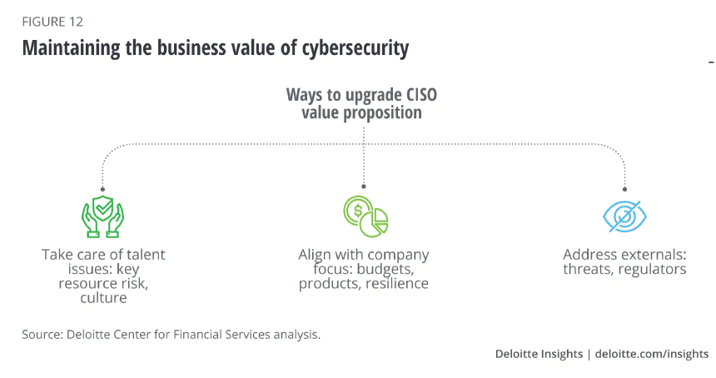

Slide 19
Why Are Organizations Increasing Spending?
74% - best practices
69% - compliance
35% - response to security incident
33% - mandates from the board
29% - responding to an incident at another org
Some orgs spend more as a type of market differentiation

Slide 20
State of Colorado CISO
“It is very difficult to determine how much money is enough, and what the right level of expenditure should be.”

Slide 21
Maturity
Broad understanding of the impacts
  SMB
    $120,000 - $1.24 million
  Large organizations
    Average of $3.92 million
  Delayed “costs” in most cases

Slide 22
Costs of Attacks
Direct Costs:
  Monetary theft
  Remediation and system repair
  Regulatory and compliance fines
  Legal and public relations fees
  Notification, identity theft repair, and credit monitoring for affected
  parties
  Increase in insurance premium
Indirect Costs:
  Business disruption and downtime
  Loss of business or customers
  Loss of intellectual property
  Damage to company credibility, brand and reputation

Slide 23
Maturity
Putting a dollar amount on the value of a cyber project, in terms of risk reduction or less costly compliance, allows comparison of the costs and value of cyber investments so they can be prioritized. Quantification also makes it easier to measure the value of the overall portfolio of cyber investments against business objectives. This kind of rigor and sophistication will be increasingly demanded — especially as the markets and regulators hold CEOs and board members more accountable for cybersecurity and privacy.
From: “Rethink your cyber budget to more out of it” - PwC

Slide 24
Innovation
Innovation is changing the cybersecurity game, giving new advantages to defenders and leveling the playing field with attackers.
3x growth in cloud services
Investing in people, processes, and technology.

Slide 25
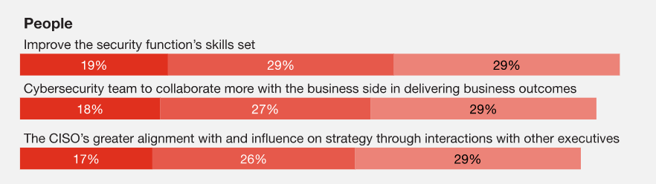
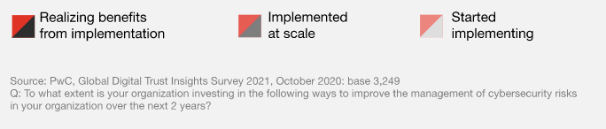
People

Slide 26
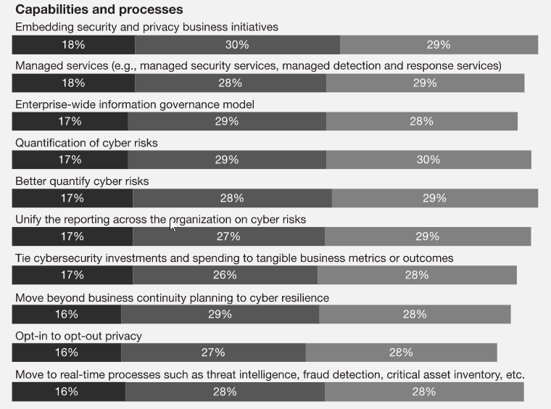
Processes

Slide 27
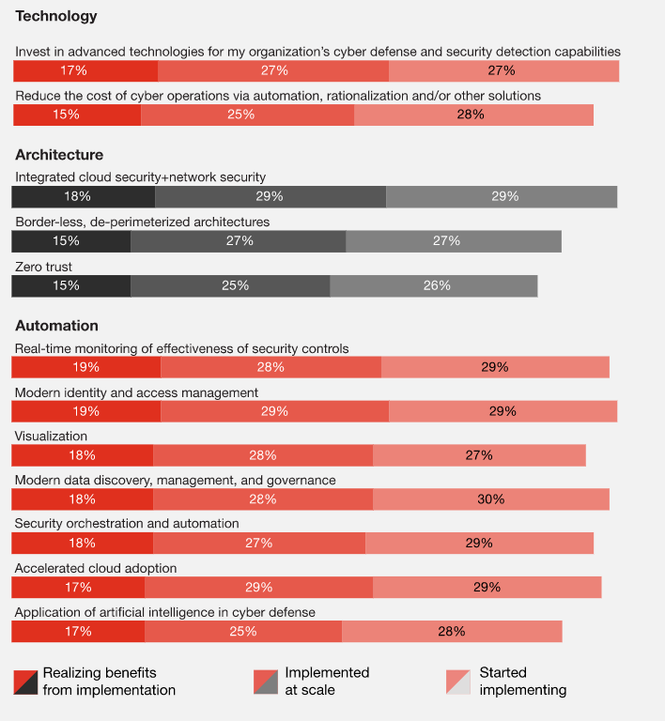
Technology

Slide 28
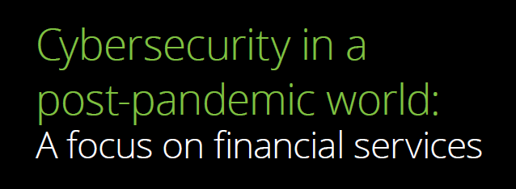
Deloitte Study

Slide 29
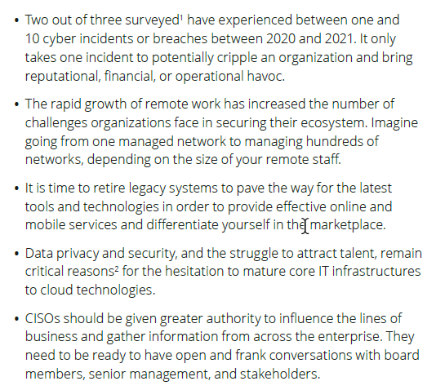
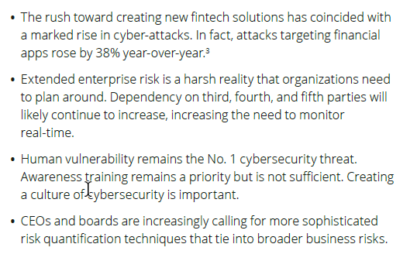
Financial Services

Slide 30
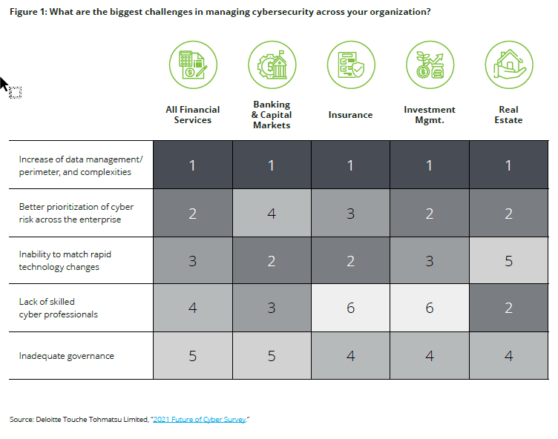

Slide 31
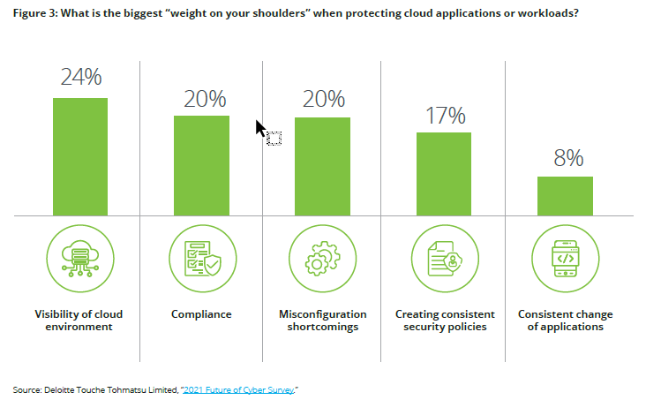

Slide 32
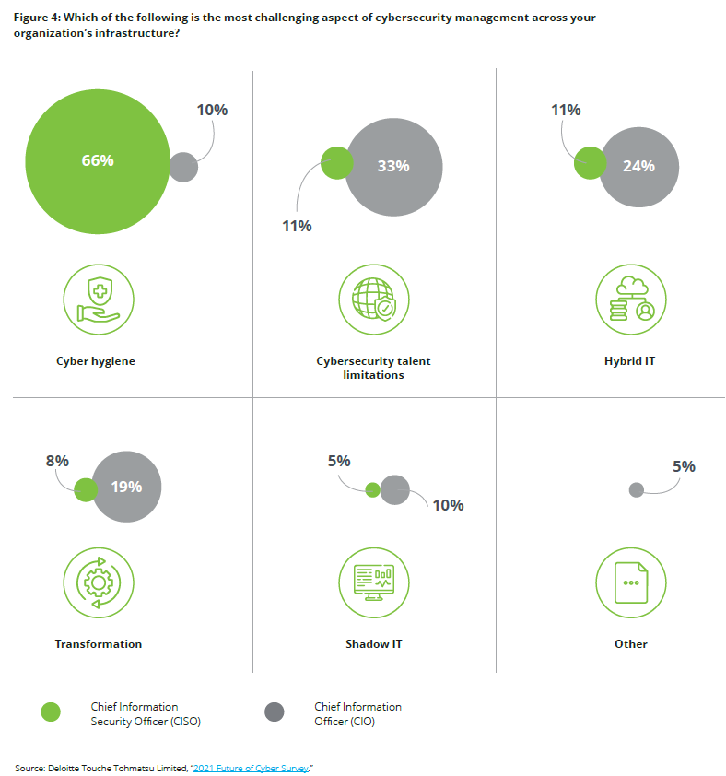

Slide 33
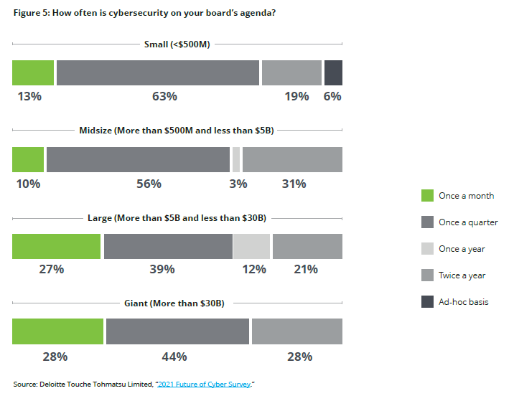

Slide 34
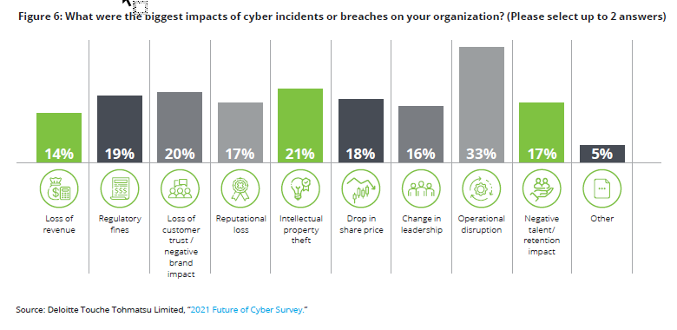

Slide 35
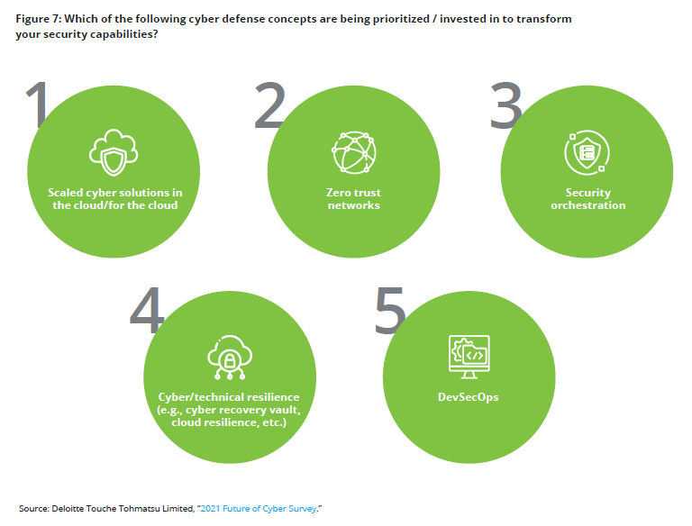

Slide 36
